Slide 1
Chapter 12 – Data Structures
Outline
12.1 Introduction
12.2 Self-Referential Structures
12.3 Dynamic Memory Allocation
12.4 Linked Lists
12.5 Stacks
12.6 Queues
12.7 Trees

Slide 2
Objectives
In this chapter, you will learn:
  To be able to allocate and free memory dynamically for data objects.
  To be able to form linked data structures using pointers, self-referential structures and recursion.
  To be able to create and manipulate linked lists, queues, stacks and binary trees.
  To understand various important applications of linked data structures.

Slide 3
12.1 Introduction
Dynamic data structures
  Data structures that grow and shrink during execution
Linked lists
  Allow insertions and removals anywhere
Stacks
  Allow insertions and removals only at top of stack
Queues
  Allow insertions at the back and removals from the front
Binary trees
  High-speed searching and sorting of data and efficient elimination of duplicate data items

Slide 4
12.2 Self-Referential Structures
Self-referential structures
  Structure that contains a pointer to a structure of the same type
  Can be linked together to form useful data structures such as lists, queues, stacks and trees
  Terminated with a NULL pointer (0)
      struct node {
      int data;
      struct node *nextPtr;
      }
nextPtr
  Points to an object of type node
  Referred to as a link
    Ties one node to another node

Slide 5
12.3 Dynamic Memory Allocation
Figure 12.1 Two self-referential structures linked together
15
10

Slide 6
12.3 Dynamic Memory Allocation
Dynamic memory allocation
  Obtain and release memory during execution
malloc
  Takes number of bytes to allocate
    Use sizeof to determine the size of an object
  Returns pointer of type void *
    A void * pointer may be assigned to any pointer
    If no memory available, returns NULL
  Example
    newPtr = malloc( sizeof( struct node ) );
free
  Deallocates memory allocated by malloc
  Takes a pointer as an argument
  free ( newPtr );

Slide 7
12.4 Linked Lists
Linked list
  Linear collection of self-referential class objects, called nodes
  Connected by pointer links
  Accessed via a pointer to the first node of the list
  Subsequent nodes are accessed via the link-pointer member of the current node
  Link pointer in the last node is set to NULL to mark the list’s end
Use a linked list instead of an array when
  You have an unpredictable number of data elements
  Your list needs to be sorted quickly

Slide 8
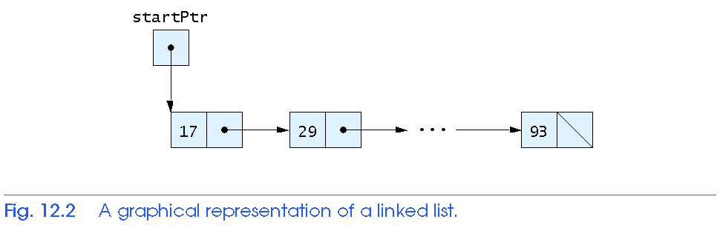
12.4 Linked Lists

Slide 9
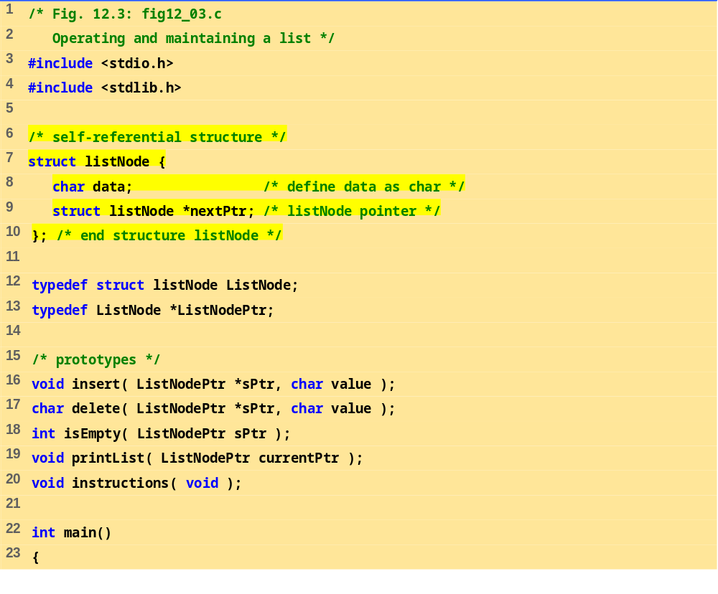
fig12_03.c (Part 1 of 8)

Slide 10
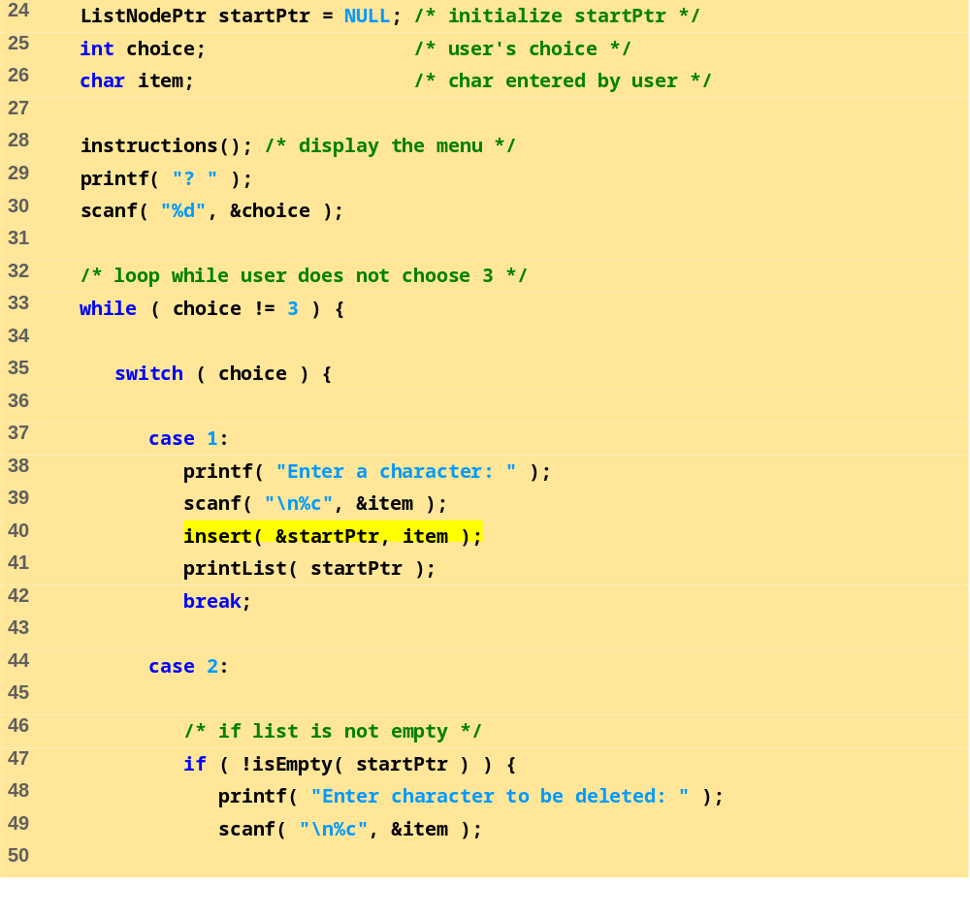
fig12_03.c (Part 2 of 8)

Slide 11
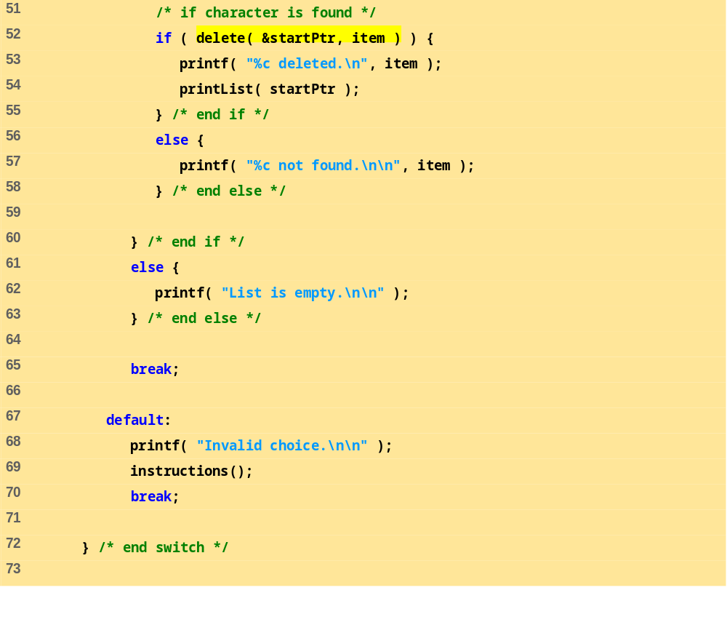
fig12_03.c (Part 3 of 8)

Slide 12
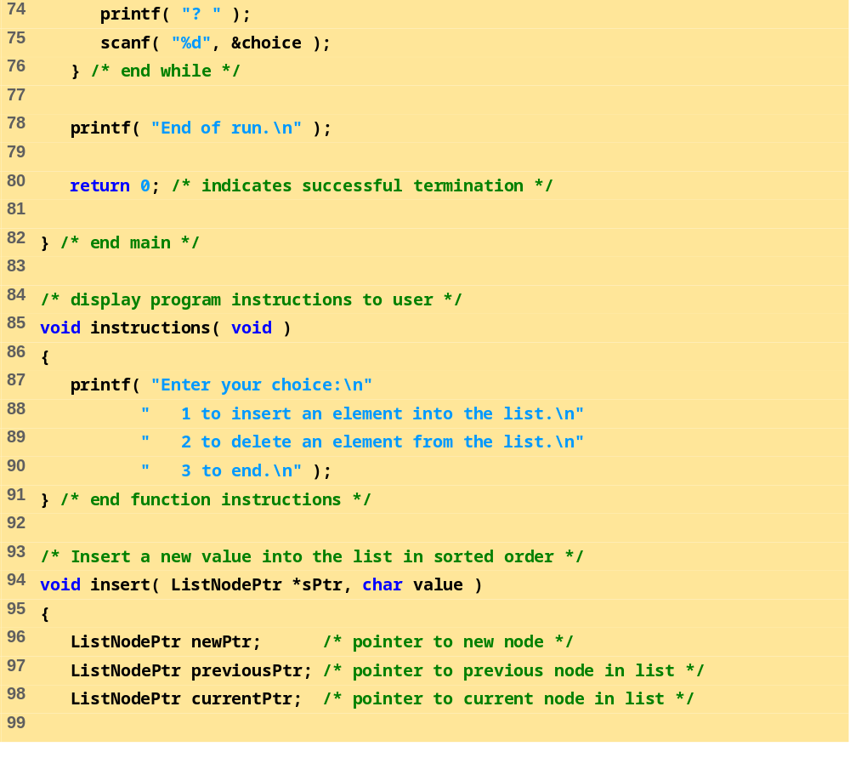
fig12_03.c (Part 4 of 8)

Slide 13
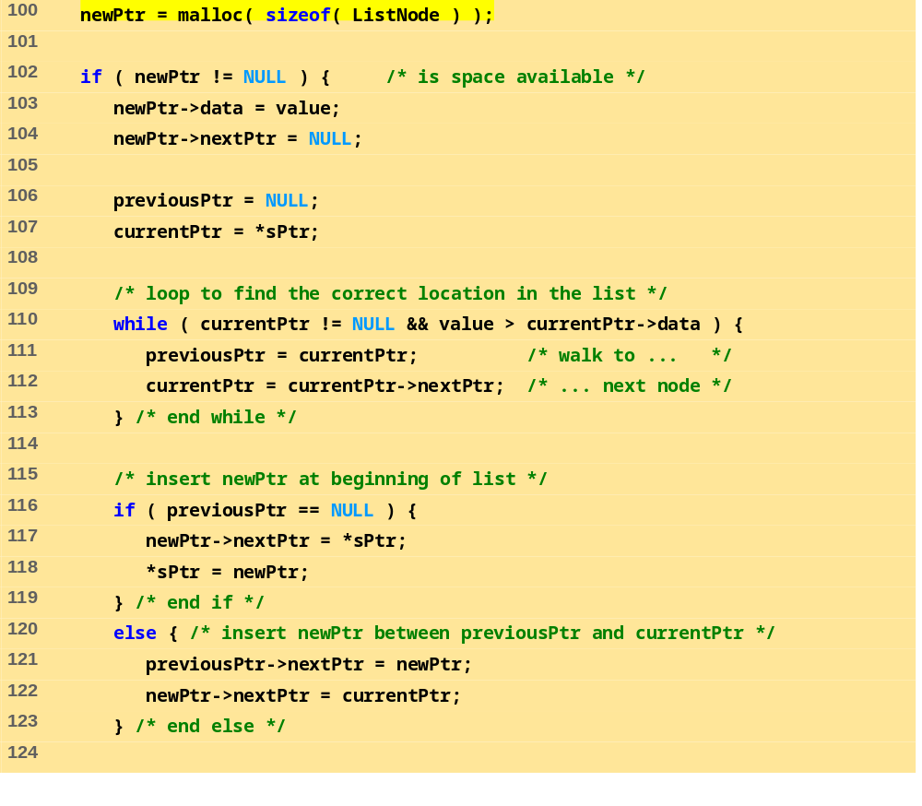
fig12_03.c (Part 5 of 8)

Slide 14
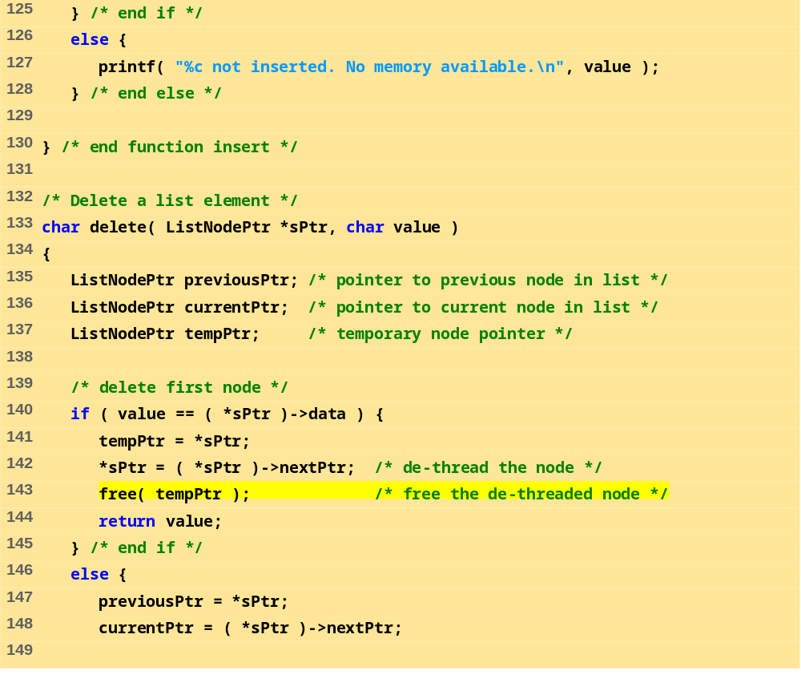
fig12_03.c (Part 6 of 8)

Slide 15
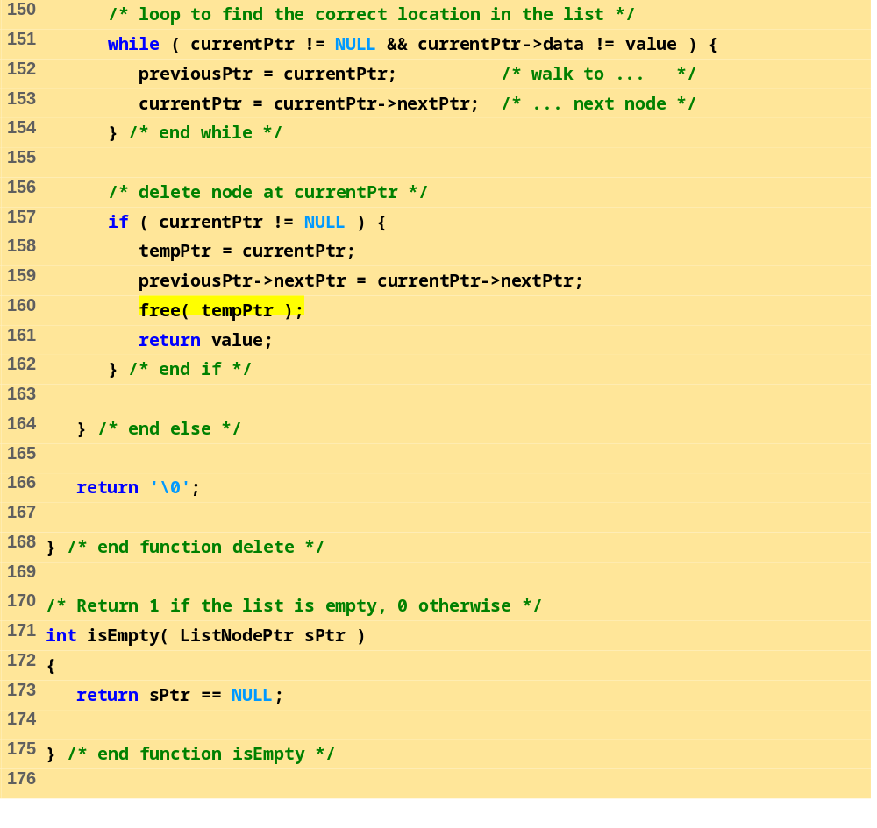
fig12_03.c (Part 7 of 8)

Slide 16
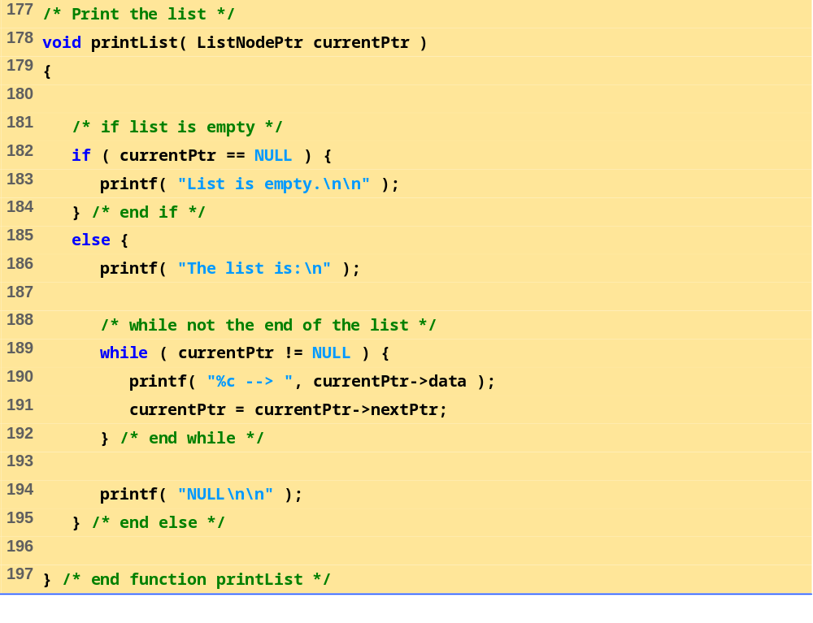
fig12_03.c (Part 8 of 8)

Slide 17
Enter your choice:
1 to insert an element into the list.
2 to delete an element from the list.
3 to end.
? 1
Enter a character: B
The list is:
B --> NULL
? 1
Enter a character: A
The list is:
A --> B --> NULL
? 1
Enter a character: C
The list is:
A --> B --> C --> NULL
? 2
Enter character to be deleted: D
D not found.
? 2
Enter character to be deleted: B
B deleted.
The list is:
A --> C --> NULL
Program Output (Part 1 of 3)

Slide 18
? 2
Enter character to be deleted: C
C deleted.
The list is:
A --> NULL
? 2
Enter character to be deleted: A
A deleted.
List is empty.
? 4
Invalid choice.
Enter your choice:
1 to insert an element into the list.
2 to delete an element from the list.
3 to end.
? 3
End of run.
? 2
Enter character to be deleted: C
C deleted.
The list is:
A --> NULL
? 2
Enter character to be deleted: A
A deleted.
List is empty.
Program Output (Part 2 of 3)

Slide 19
? 4
Invalid choice.
Enter your choice:
1 to insert an element into the list.
2 to delete an element from the list.
3 to end.
? 3
End of run.
Program Output (Part 3 of 3)

Slide 20
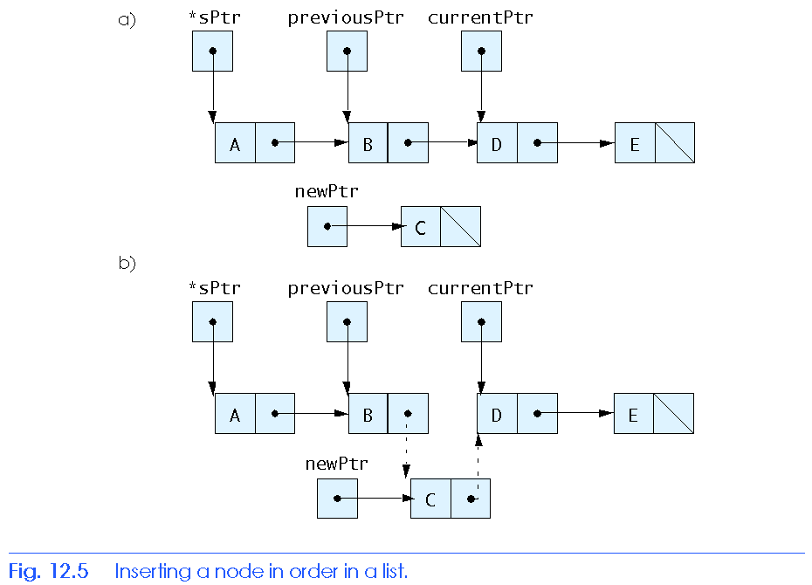
12.4 Linked Lists

Slide 21
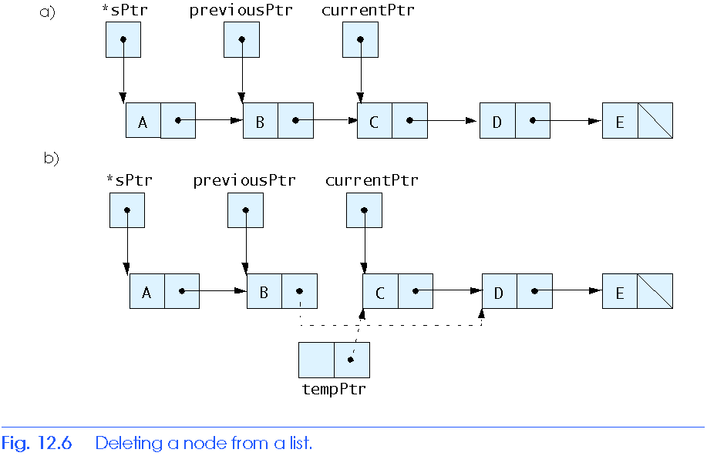
12.5 Stacks

Slide 22
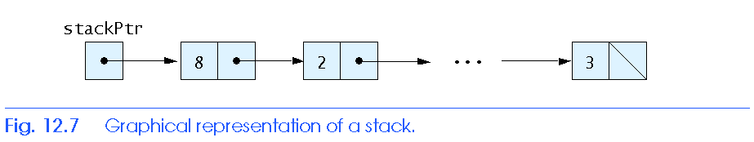
12.5 Stacks

Slide 23
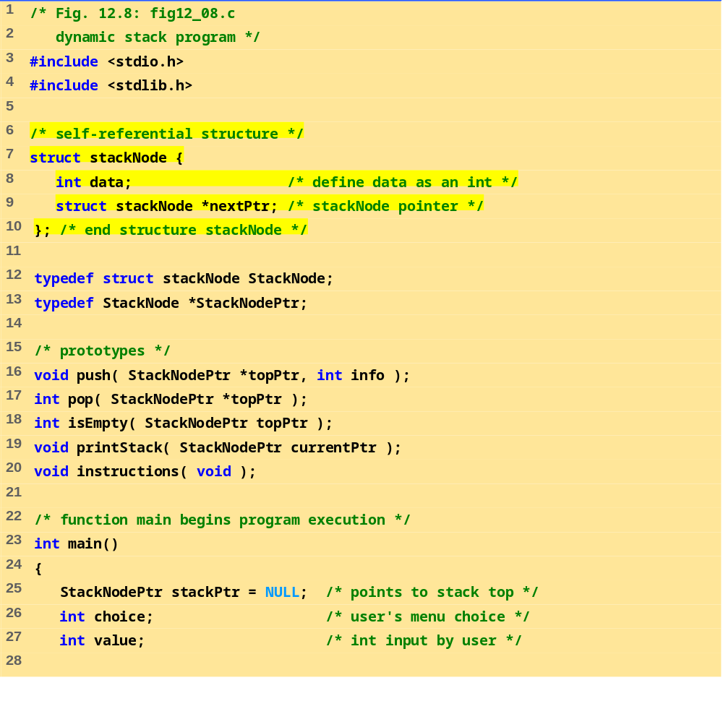
fig12_08.c (Part 1 of 6)

Slide 24
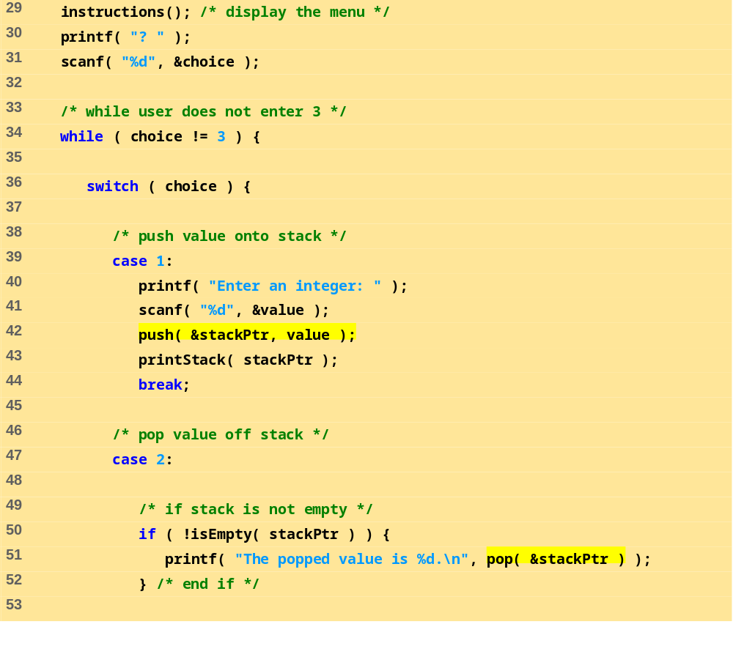
fig12_08.c (Part 2 of 6)

Slide 25
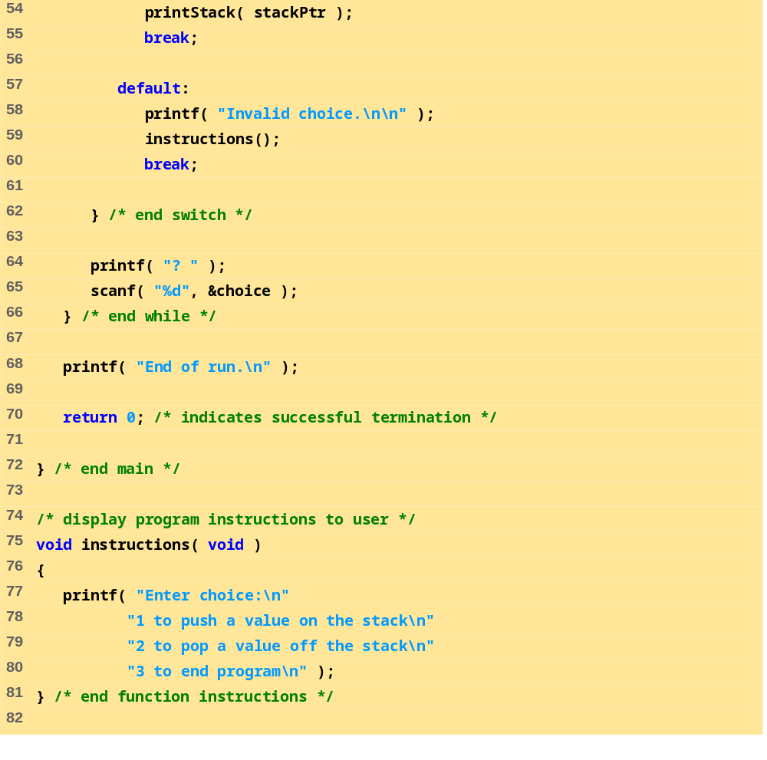
fig12_08.c (Part 3 of 6)

Slide 26
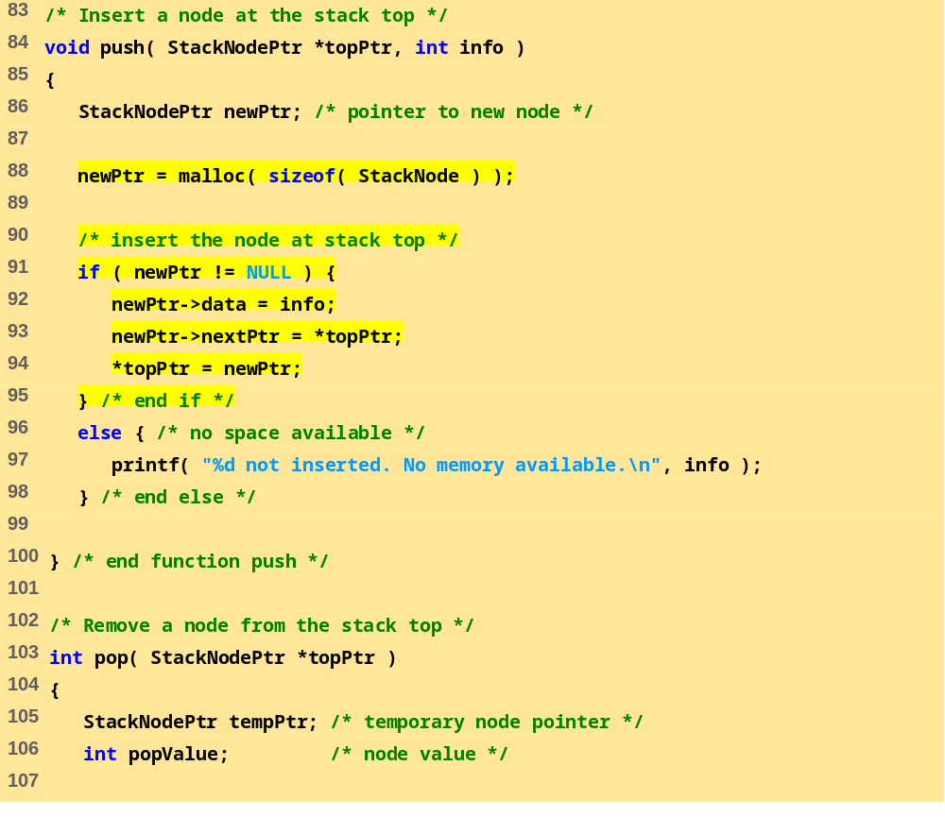
fig12_08.c (Part 4 of 6)

Slide 27
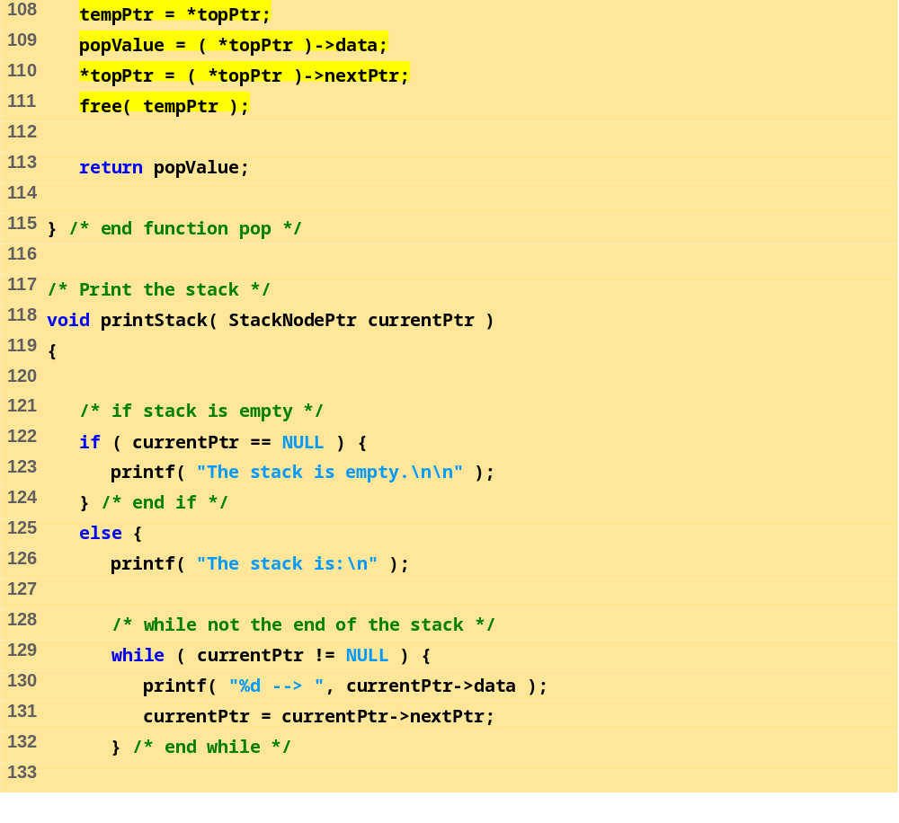
fig12_08.c (Part 5 of 6)

Slide 28
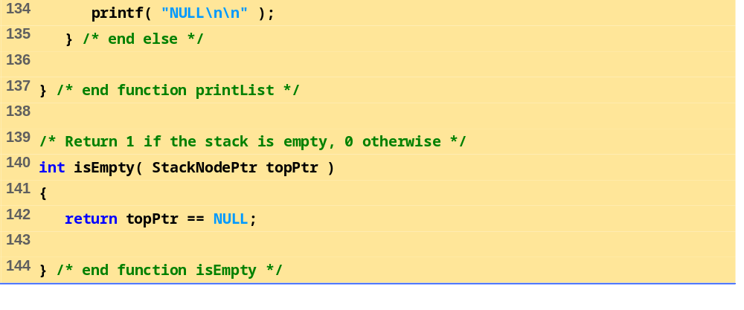
fig12_08.c (Part 6 of 6)
Program Output (Part 1 of 2)
Enter choice:
1 to push a value on the stack
2 to pop a value off the stack
3 to end program
? 1
Enter an integer: 5
The stack is:
5 --> NULL
? 1
Enter an integer: 6
The stack is:
6 --> 5 --> NULL

Slide 29
? 1
Enter an integer: 4
The stack is:
4 --> 6 --> 5 --> NULL
? 2
The popped value is 4.
The stack is:
6 --> 5 --> NULL
? 2
The popped value is 6.
The stack is:
5 --> NULL
? 2
The popped value is 5.
The stack is empty.
? 2
The stack is empty.
? 4
Invalid choice.
Enter choice:
1 to push a value on the stack
2 to pop a value off the stack
3 to end program
? 3
End of run.
Program Output (Part 2 of 2)

Slide 30
12.5 Stacks
Stack
  New nodes can be added and removed only at the top
  Similar to a pile of dishes
  Last-in, first-out (LIFO)
  Bottom of stack indicated by a link member to NULL
  Constrained version of a linked list
push
  Adds a new node to the top of the stack
pop
  Removes a node from the top
  Stores the popped value
  Returns true if pop was successful

Slide 31
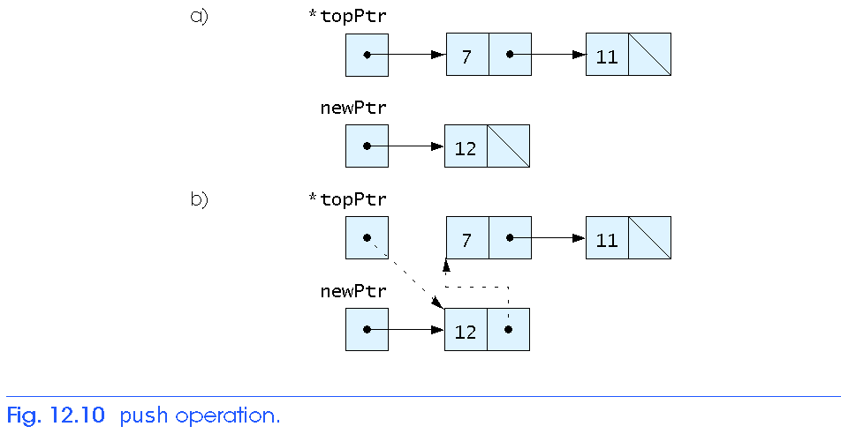
12.5 Stacks

Slide 32
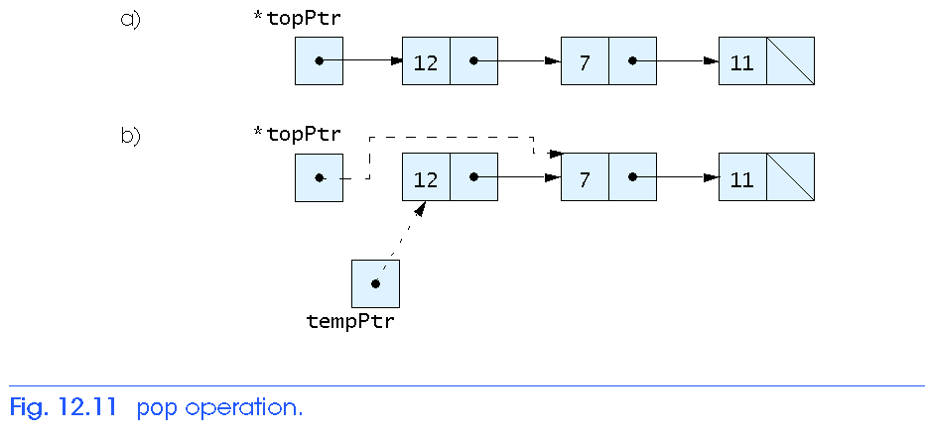
12.5 Stacks

Slide 33
12.6 Queues
Queue
  Similar to a supermarket checkout line
  First-in, first-out (FIFO)
  Nodes are removed only from the head
  Nodes are inserted only at the tail
Insert and remove operations
  Enqueue (insert) and dequeue (remove)

Slide 34
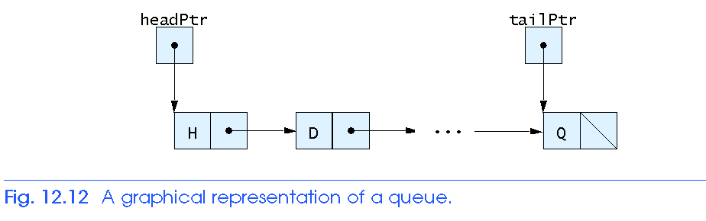
12.6 Queues

Slide 35
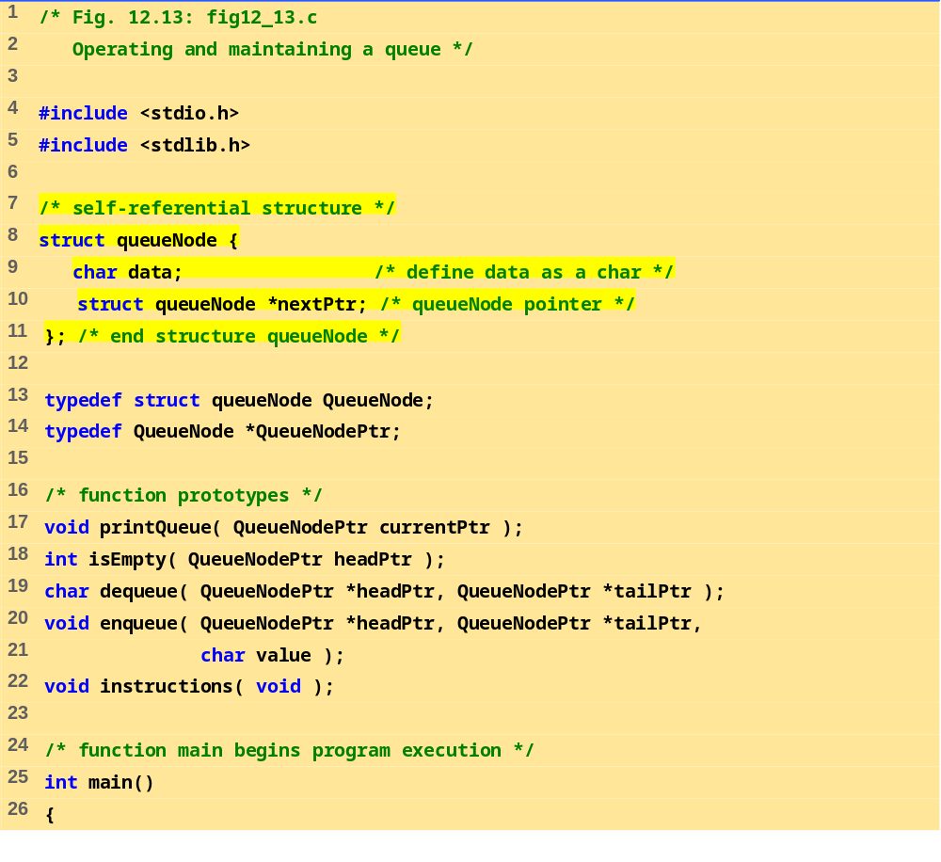
fig12_13.c (Part 1 of 7)

Slide 36
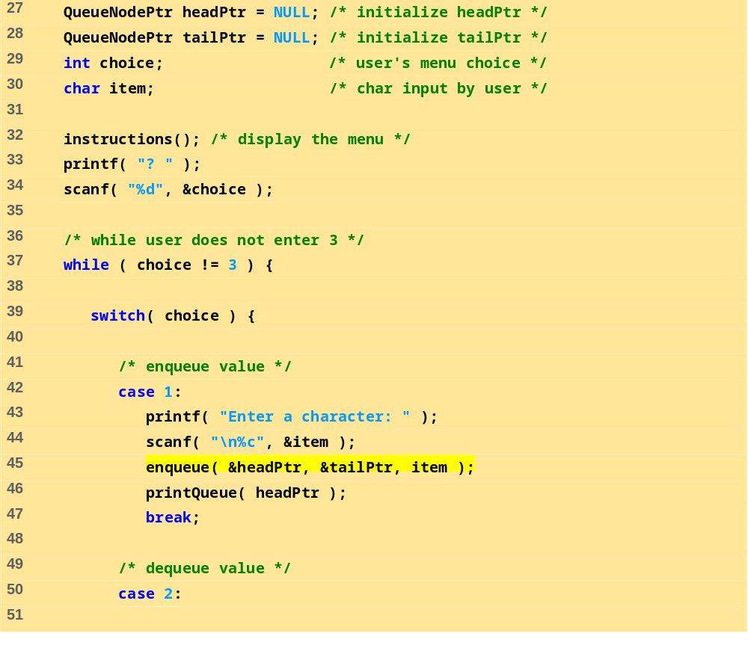
fig12_13.c (Part 2 of 7)

Slide 37
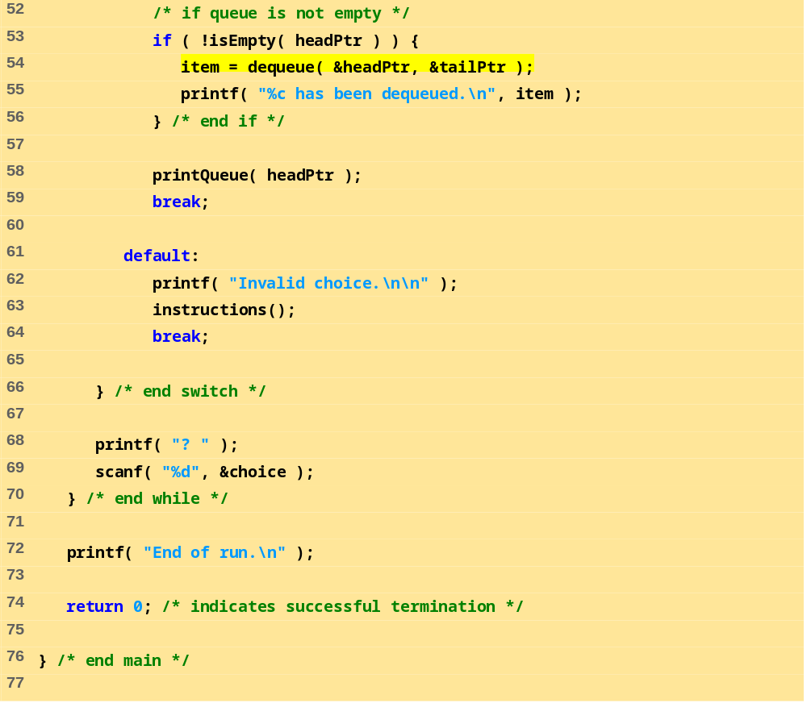
fig12_13.c (Part 3 of 7)

Slide 38
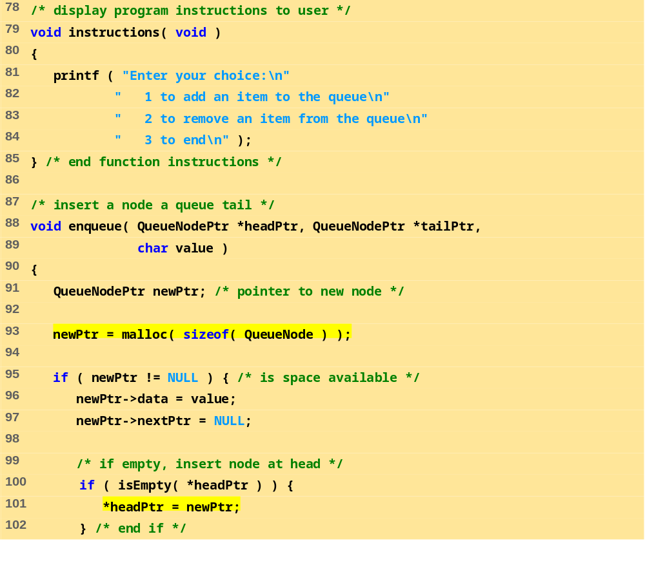
fig12_13.c (Part 4 of 7)

Slide 39
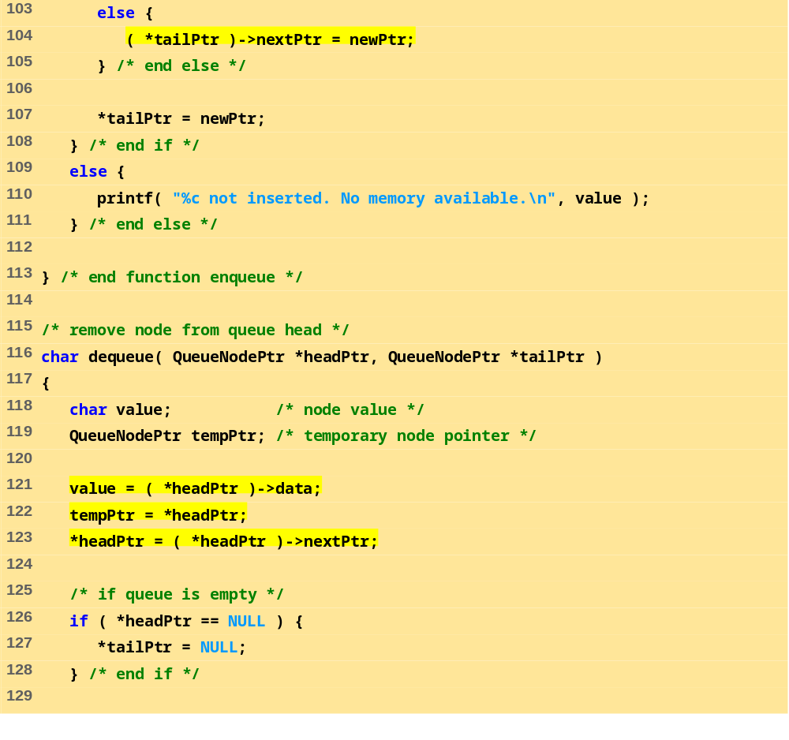
fig12_13.c (Part 5 of 7)

Slide 40
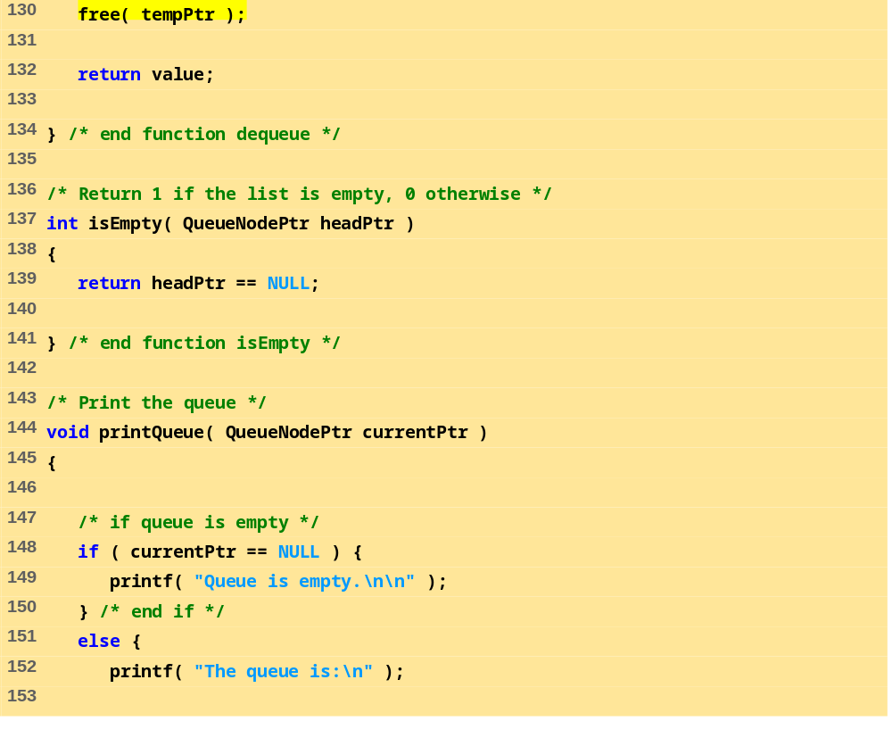
fig12_13.c (Part 6 of 7)

Slide 41
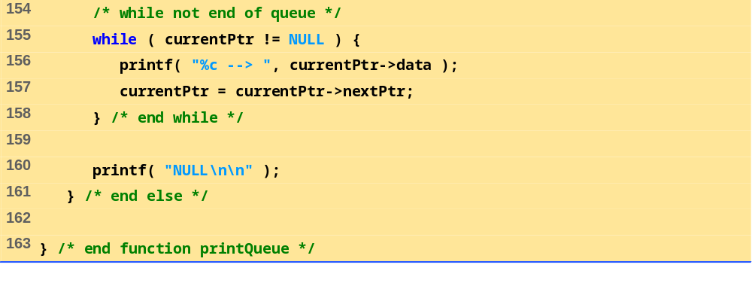
fig12_13.c (Part 7 of 7)
Program Output (Part 1 of 2)
Enter your choice:
1 to add an item to the queue
2 to remove an item from the queue
3 to end
? 1
Enter a character: A
The queue is:
A --> NULL
? 1
Enter a character: B
The queue is:
A --> B --> NULL
? 1
Enter a character: C
The queue is:
A --> B --> C --> NULL

Slide 42
? 2
A has been dequeued.
The queue is:
B --> C --> NULL
? 2
B has been dequeued.
The queue is:
C --> NULL
? 2
C has been dequeued.
Queue is empty.
? 2
Queue is empty.
? 4
Invalid choice.
Enter your choice:
1 to add an item to the queue
2 to remove an item from the queue
3 to end
? 3
End of run.
Program Output (Part 2 of 2)

Slide 43
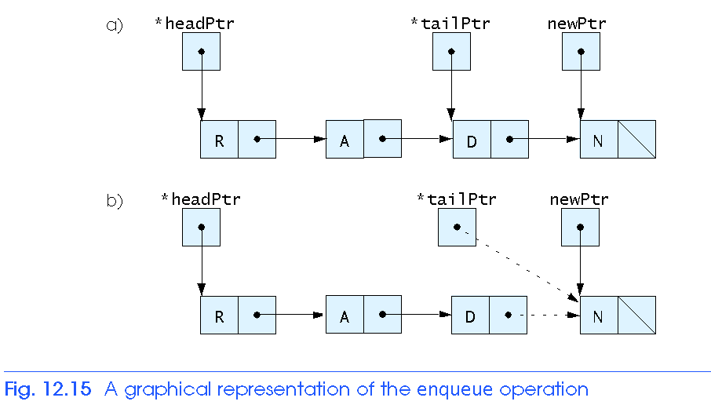
12.6 Queues

Slide 44
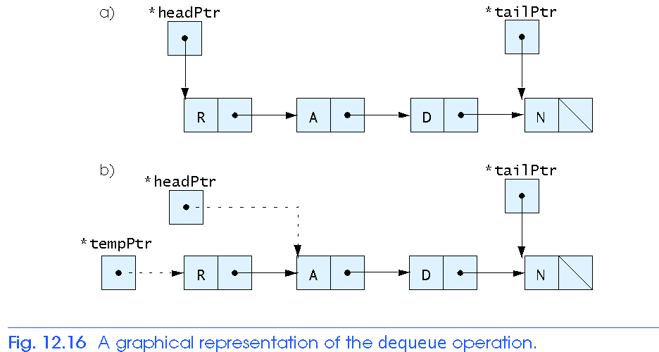
12.6 Queues

Slide 45
12.7 Trees
Tree nodes contain two or more links
  All other data structures we have discussed only contain one
Binary trees
  All nodes contain two links
    None, one, or both of which may be NULL
  The root node is the first node in a tree.
  Each link in the root node refers to a child
  A node with no children is called a leaf node

Slide 46
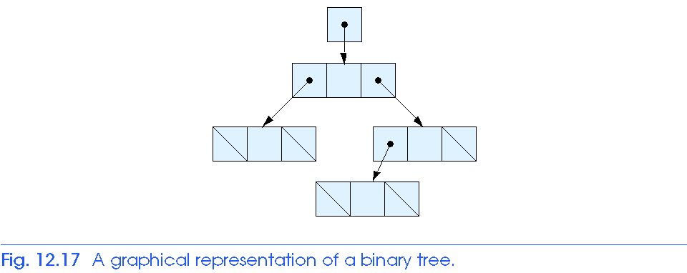
12.7 Trees

Slide 47
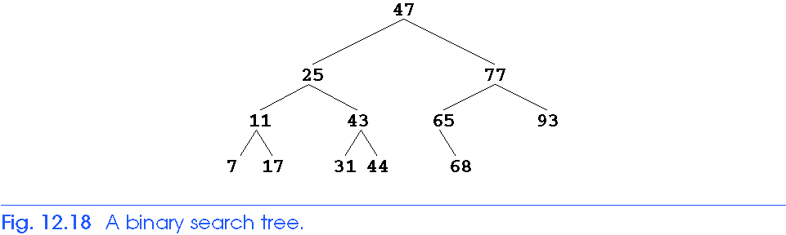
12.7 Trees
Binary search tree
  Values in left subtree less than parent
  Values in right subtree greater than parent
  Facilitates duplicate elimination
  Fast searches - for a balanced tree, maximum of log n comparisons
2

Slide 48
12.7 Trees
Tree traversals:
  Inorder traversal – prints the node values in ascending order
    1. Traverse the left subtree with an inorder traversal
    2. Process the value in the node (i.e., print the node value)
    3. Traverse the right subtree with an inorder traversal
  Preorder traversal
    1. Process the value in the node
    2. Traverse the left subtree with a preorder traversal
    3. Traverse the right subtree with a preorder traversal
  Postorder traversal
    1. Traverse the left subtree with a postorder traversal
    2. Traverse the right subtree with a postorder traversal
    3. Process the value in the node

Slide 49
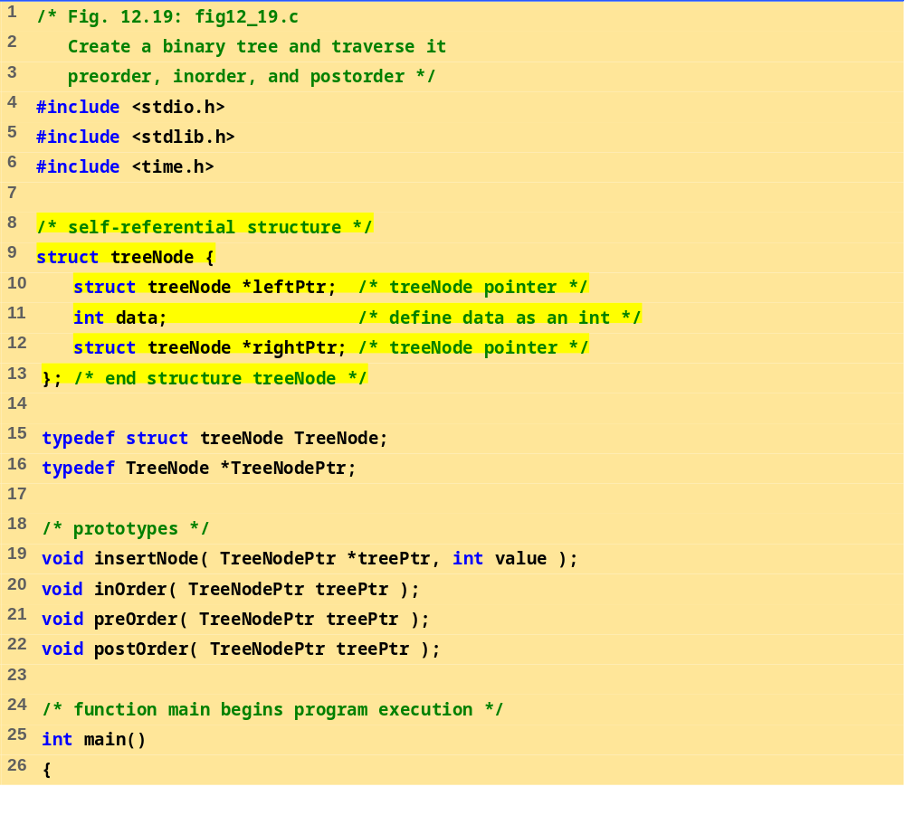
fig12_19.c (Part 1 of 6)

Slide 50
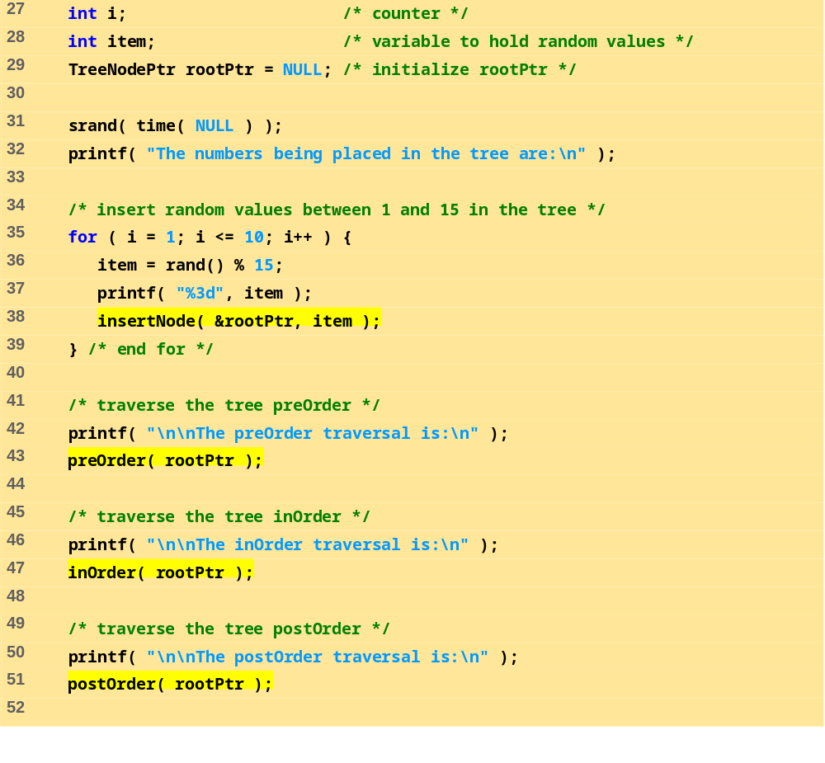
fig12_19.c (Part 2 of 6)

Slide 51
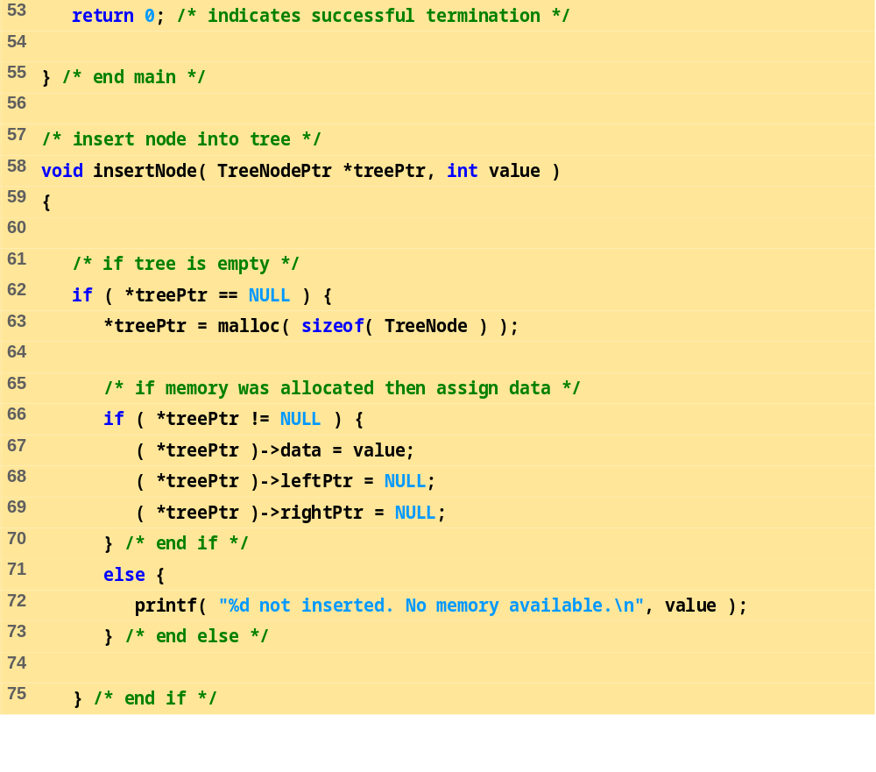
fig12_19.c (Part 3 of 6)

Slide 52
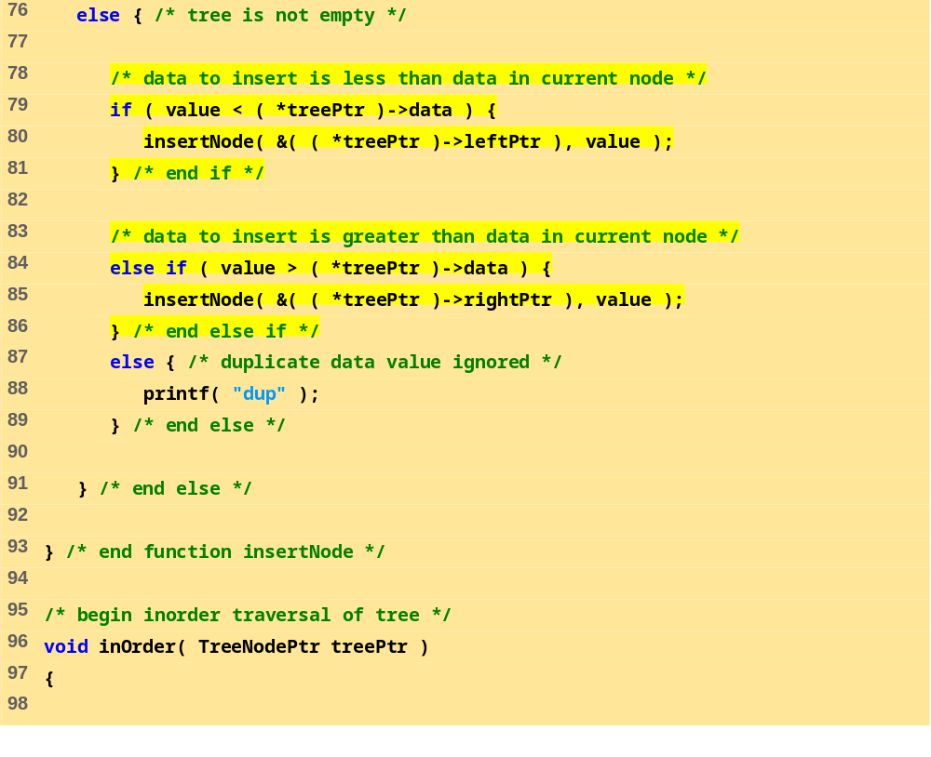
fig12_19.c (Part 4 of 6)

Slide 53
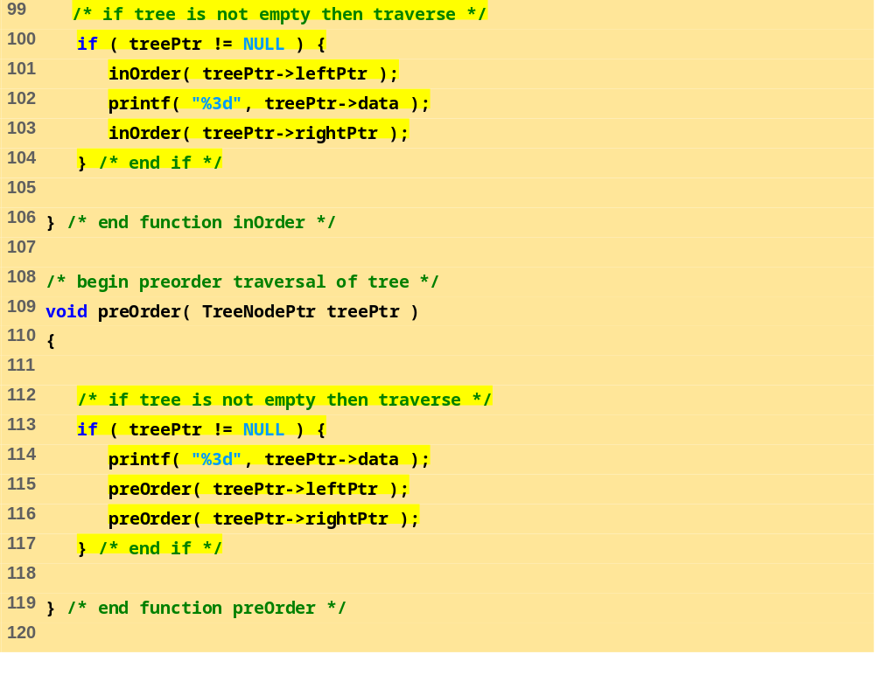
fig12_19.c (Part 5 of 6)

Slide 54
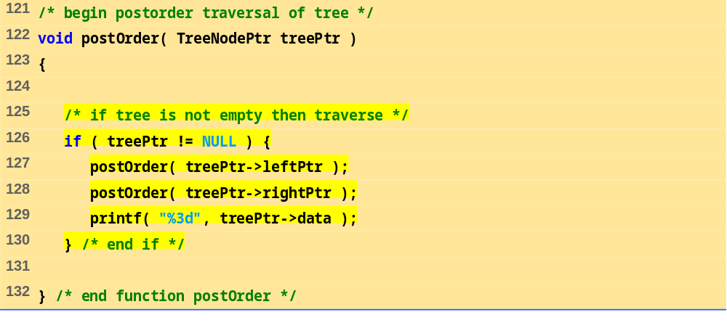
fig12_19.c (Part 6 of 6)
Program Output
The numbers being placed in the tree are:
6 7 4 12 7dup 2 2dup 5 7dup 11
The preOrder traversal is:
6 4 2 5 7 12 11
The inOrder traversal is:
2 4 5 6 7 11 12
The postOrder traversal is:
2 5 4 11 12 7 6

Slide 55
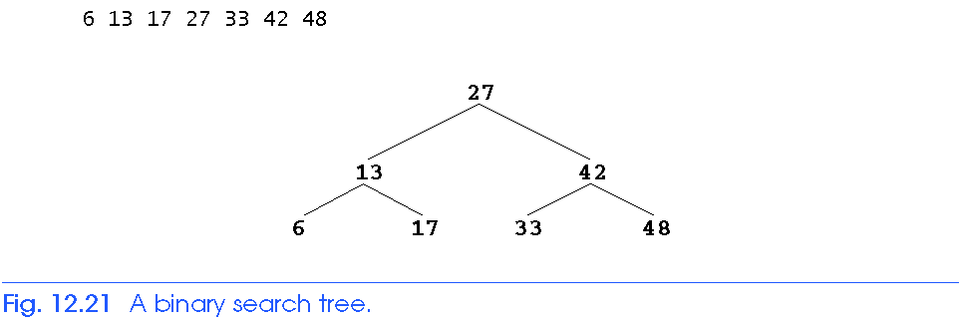
12.7 Trees

